Slide 1

Exploring COVID-19 Data Analysis

Slide 2
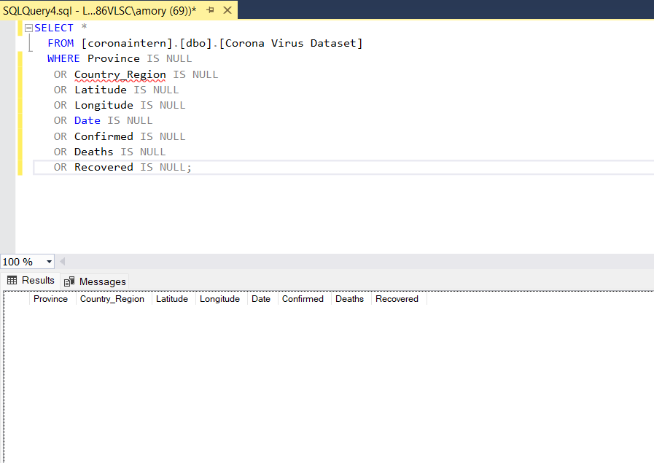
Q1. Check for NULL Values

Slide 3
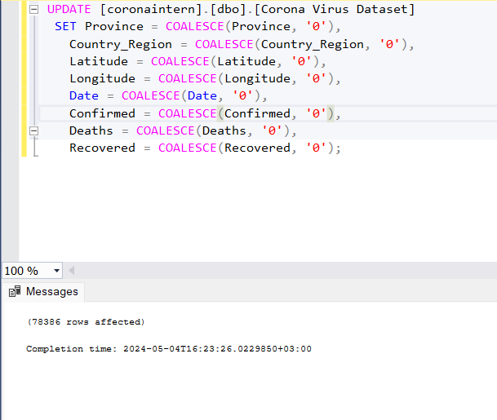
Q2. Fill Missing Values with Zeroes

Slide 4
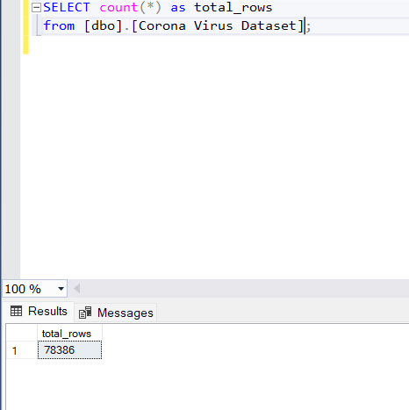
Q3. Total Number of Rows

Slide 5
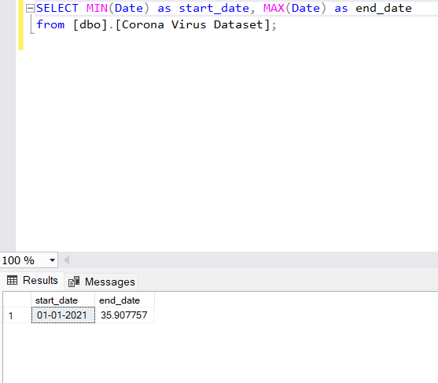
Q4. Determine Start and End Dates

Slide 6
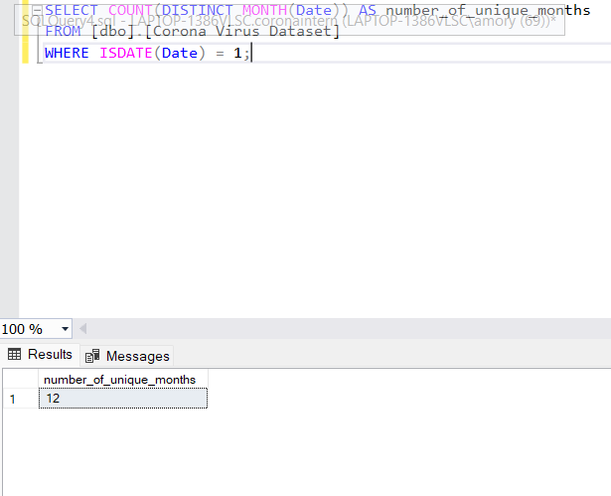
Q5. Count Number of Unique Months

Slide 7
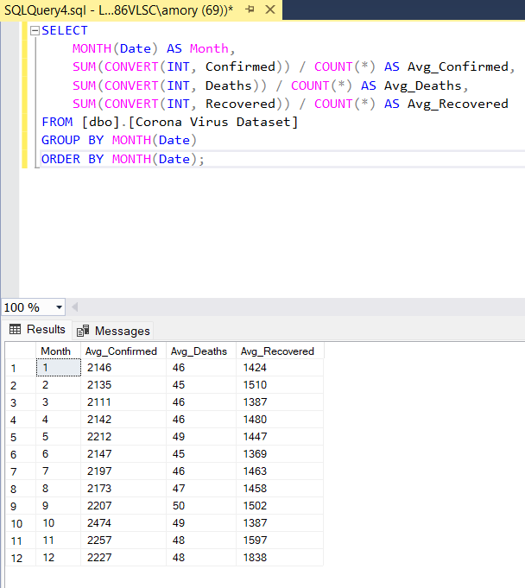
Q6. Monthly Averages for Cases

Slide 8
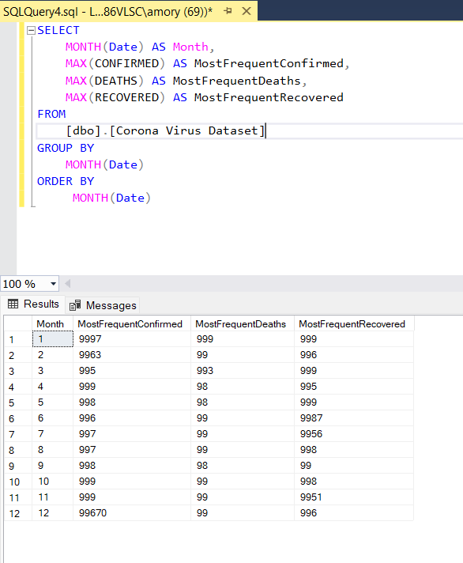
Q7. Most Frequent Values per Month

Slide 9
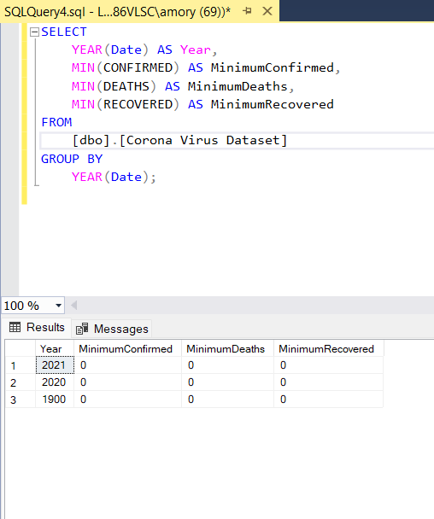
Q8. Minimum Values per Year

Slide 10
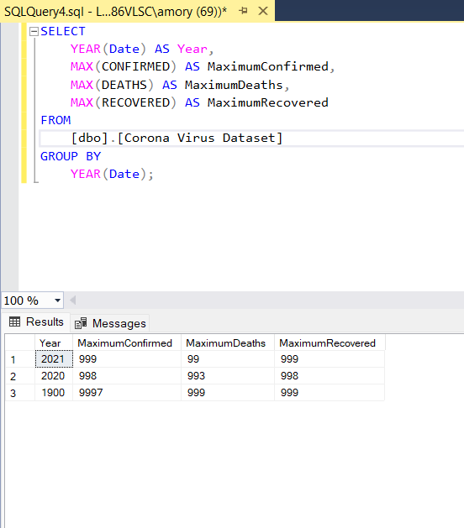
Q9. Maximum Values per Year

Slide 11
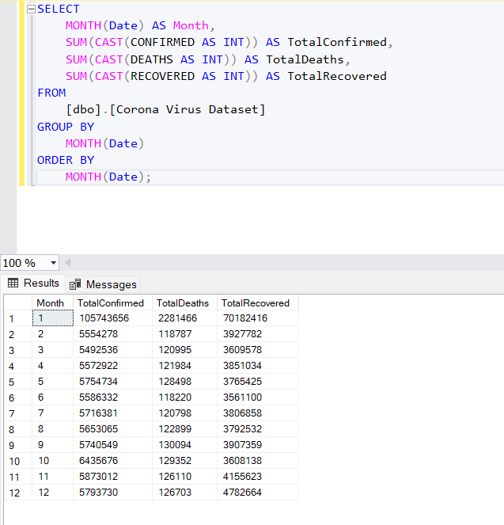
Q10. Total Cases per Month

Slide 12
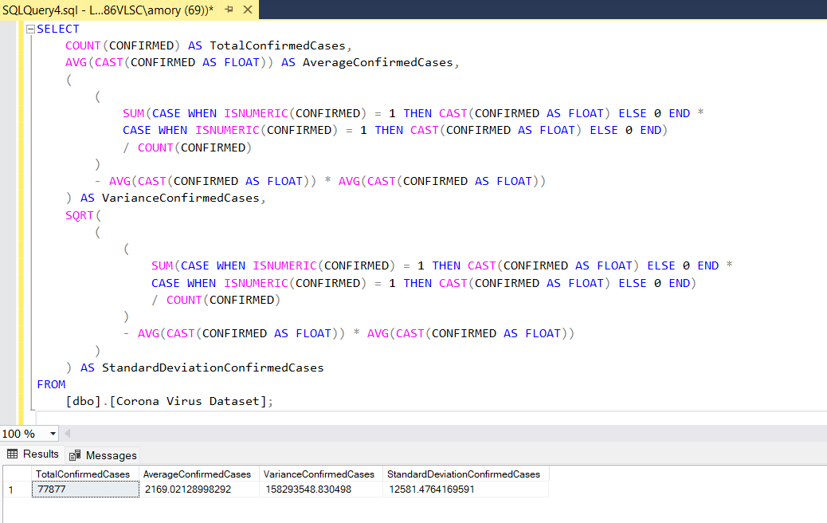
Q11. Spread of COVID-19: Confirmed Cases Analysis

Slide 13
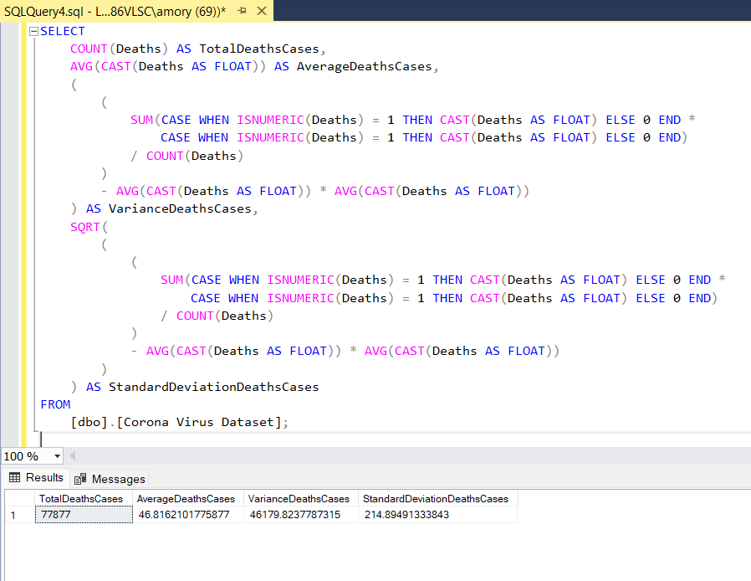
Q12. Spread of COVID-19: Death Cases Analysis per Month

Slide 14
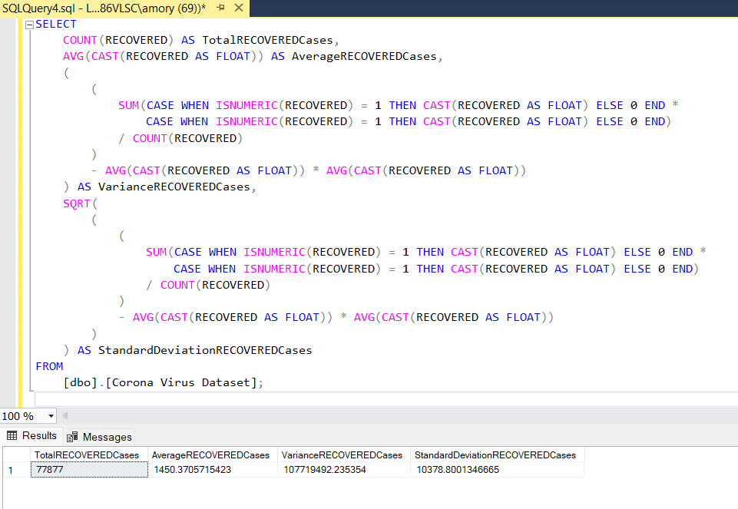
Q13. Spread of COVID-19: Recovered Cases Analysis

Slide 15
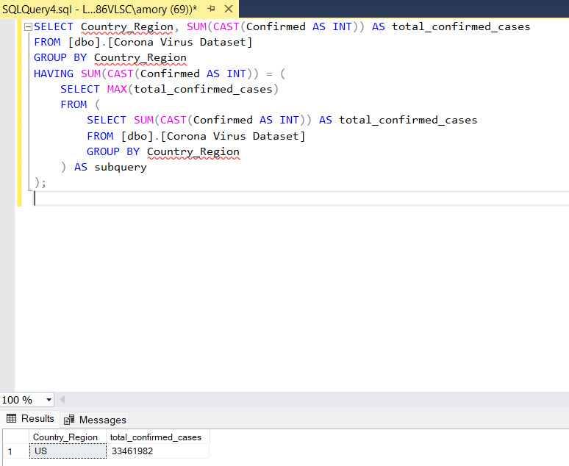
Q14. Country with Highest Confirmed Cases

Slide 16
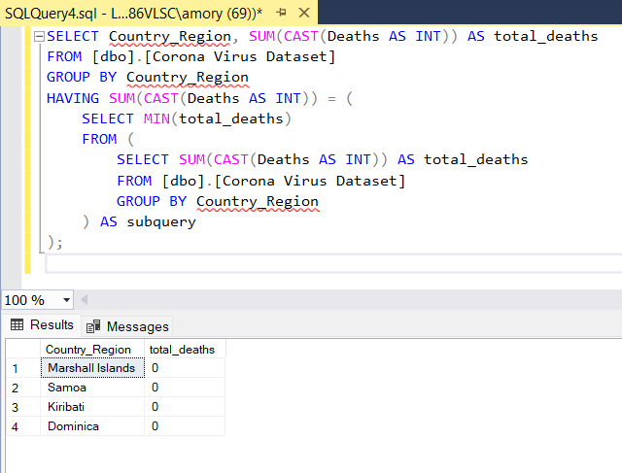
Q15. Country with Lowest Death Cases

Slide 17
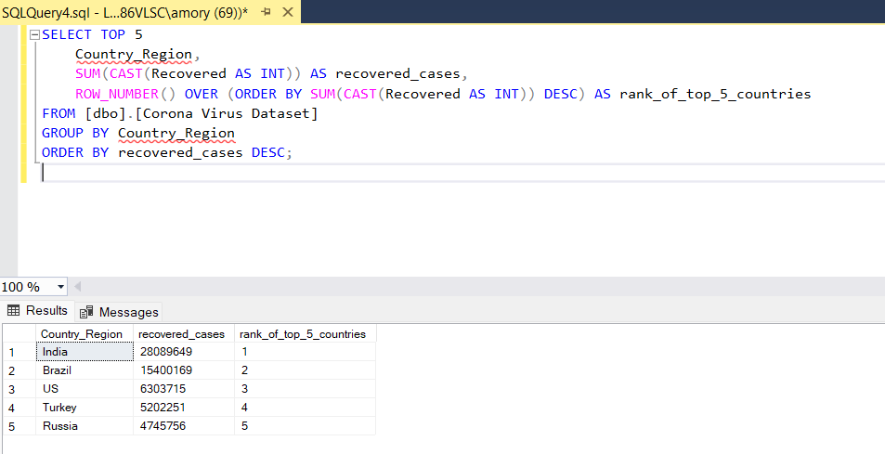
Q16. Top 5 Countries with Highest Recovered Cases

